Slide 1


TRACKING MOVING OBJECTS IN VIDEOS
USING OPENCV, KALMAN FILTERING, AND MACHINE LEARNING
Farhana Akter
2212084642
Tasadduk Hossain
2131083642
Shuvra Saha
2122468642

Slide 2

MOTIVATION
CHALLENGES:
01
Traffic monitoring
02
Robotics
Need for motion prediction
Tracker drift or loss
03
Sports analytics
04
Surveillance
Noisy detection

Slide 3


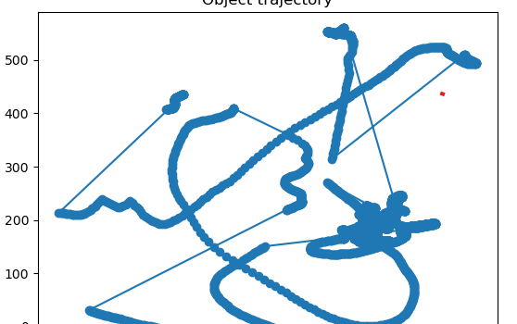
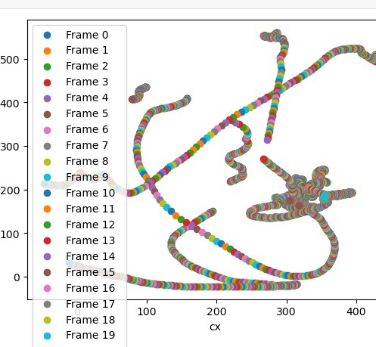
SYSTEM WORKFLOW
Input: Multiple videos →
ROI selection (manual / auto) OpenCV Tracker (CSRT/KCF/MOSSE)
Kalman Filter (smooth trajectory)
Save outputs: Annotated video
CSV (frame, time, bbox, centroid)
Next step: Train ML model to predict future centroids from CSVs

Slide 4


TRACKERS USED
CSRT
(accurate, slower)
KFC
(faster)
MOSSE
(very fast, less accurate)
Auto -init via Motion Detection
(first 60 frames)
Outputs: Bounding box, trajectory, centroid

Slide 5

PREDICTION MODULE
Build dataset from CSVs
Features : Last W =15 frames of centroids
Labels : next (cx , cy ) position
Model : Ridge Regression(baseline)
Metric : Mean Absolute Error(MAE)

Slide 6

RESULTS
MAE (validation) : cx: 49.25 px ll cy: 28.86 px
Interpretation : Predictions within ~ 2-3% of video resolution
Better vertical accuracy than horizontal
Limitations
Linear Model : Struggles with nonlinear motion
Horizontal error higher due to frequent side movement
Accuracy depends on tracker quality

Slide 7

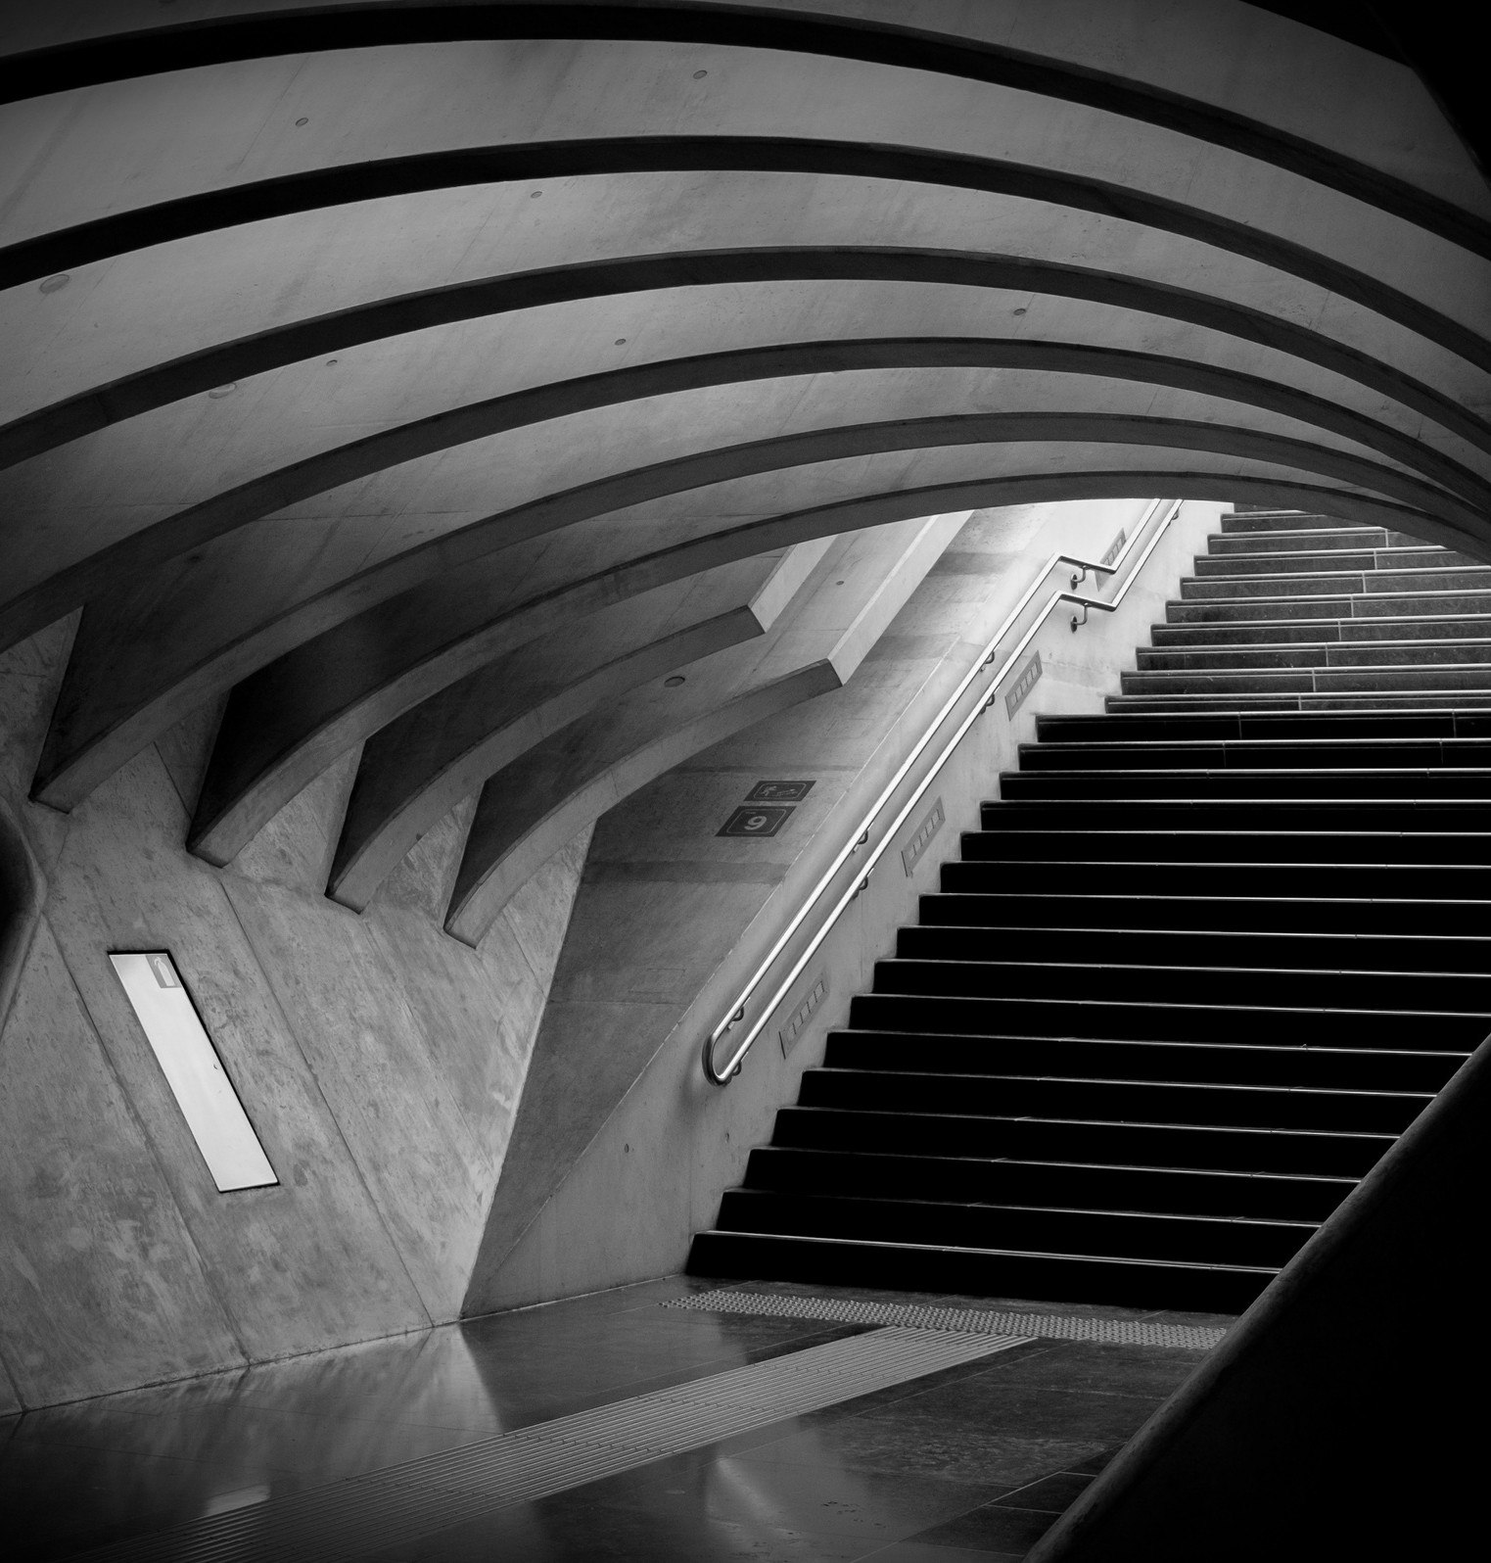

FUTURE WORK
Try advanced models (Random Forest, LSTM, Transformer
Multi-step prediction (forecast several frames ahead)
Handle multi-object tracking Integrate real-time alerts when tracking is lost

Slide 8
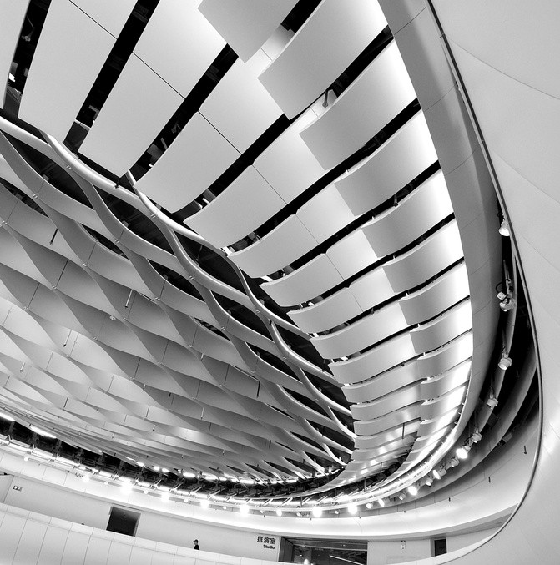
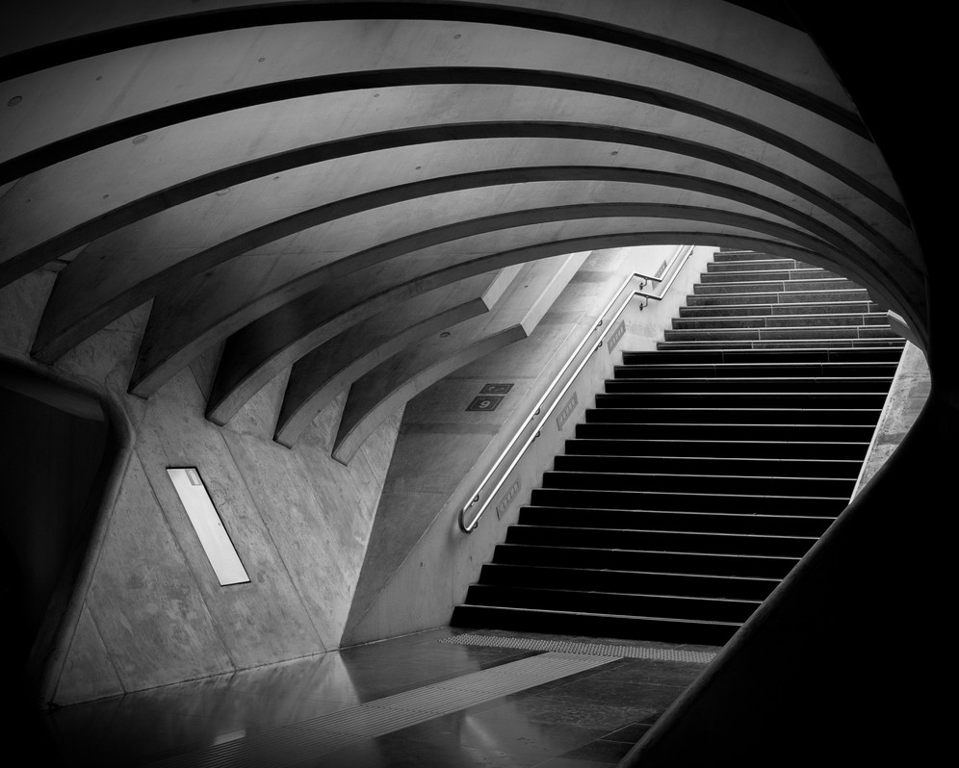
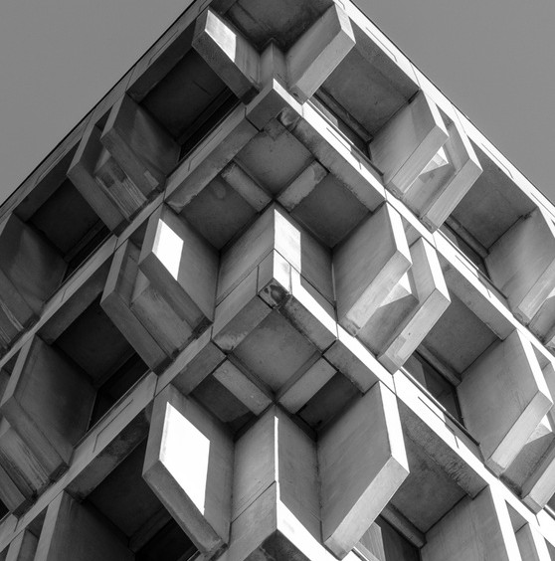
CONCLUSION
BUILT A FULL PIPELINE:
Video tracking with OpenCV
Trajectory smoothing with Kalman filter
Motion prediction using ML

